Slide 1

Problem 3
Output variable prediction with logistic regression, classification tree, random forest, and neural network models
Vlad Stefan, Jorge Guerra, Jun Tateiwa, Jean-Baptise Joannic, Axel Fridell

Slide 2
Agenda
Introduction
Logistic Regression Model
Classification Tree Model
Random Forest Model
Neural Network Model
Best Model

Slide 3
Agenda
Introduction
Logistic Regression Model
Classification Tree Model
Random Forest Model
Neural Network Model
Best Model

Slide 4
Introduction
Goal: Create a model capable of solving a binary classification problem
Determine whether a client of a bank has subscribed to a term deposit
Dataset contains information from 10,000 people
Train-test split = 75%—25%
19 explanatory variables
1 binary output variable
Created models:
Logistic regression
Classification tree
Random forest
Neural network

Slide 5
Agenda
Introduction
Logistic Regression Model
Classification Tree Model
Random Forest Model
Neural Network Model
Best Model

Slide 6


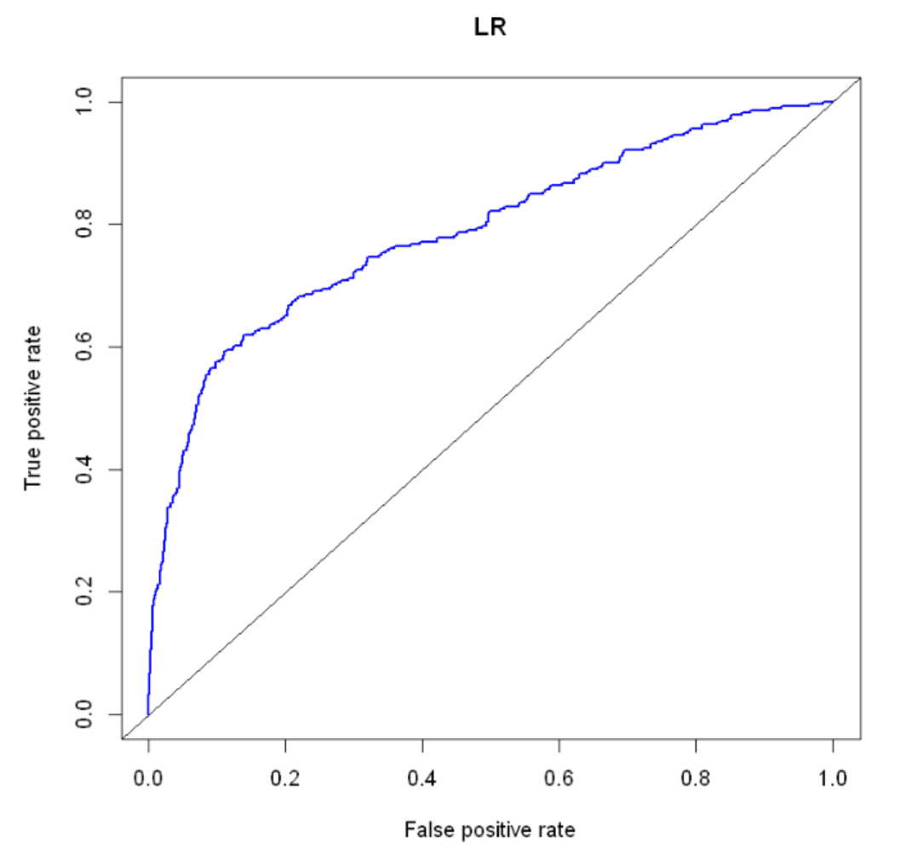
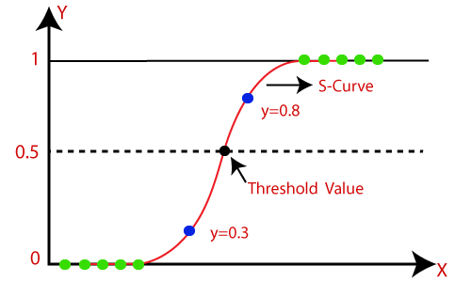
Logistic Regression Model
Predict probability of binary output
To make a prediction we set a threshold value τ
AUC of 0.7875
Figure 1: Logistic regression example
Figure 2: Logistic regression ROC curve
Notes:
Used to predict the probability that an event will occur where the event only can take two values
Formula on the right represents the probability that the response variable will be equal to 1
To make a prediction based on the output of the logistic function, we set a threshold value τ
If P(τ) is greater than equal to the threshold value, the event is predicted to occur
Implemented with glm function from the stats R package
One-hot encoding applied to be able to use the categorical explanatory variables
AUC of 0.7875

Slide 7
Agenda
Introduction
Logistic Regression Model
Classification Tree Model
Random Forest Model
Neural Network Model
Best Model

Slide 8
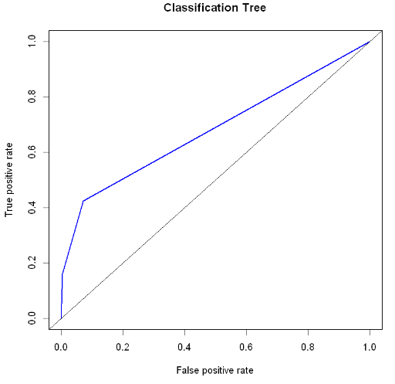

Classification Tree Model
Partition explanatory variables into subsets and fit a simple model on each one
Tree-like structure which consists of a series of decision nodes, branches, and leaf nodes
Prone to overfitting
Tree pruned to remove unnecessary branches
AUC = 0.6815
Figure 4: Classification tree ROC curve
Figure 3: Classification tree example
Notes:
Non-linear regression analysis used to predict a categorical response value
Partition the set of explanatory variables into a set of rectangles and fitting a simple model in each one
A Tree-like model which consists of a series of decision nodes, branches and leaf nodes
Prone to overfitting
Often necessary to prune the tree by removing unnecessary branches or limiting the depth of the tree

Slide 9
Agenda
Introduction
Logistic Regression Model
Classification Tree Model
Random Forest Model
Neural Network Model
Best Model

Slide 10
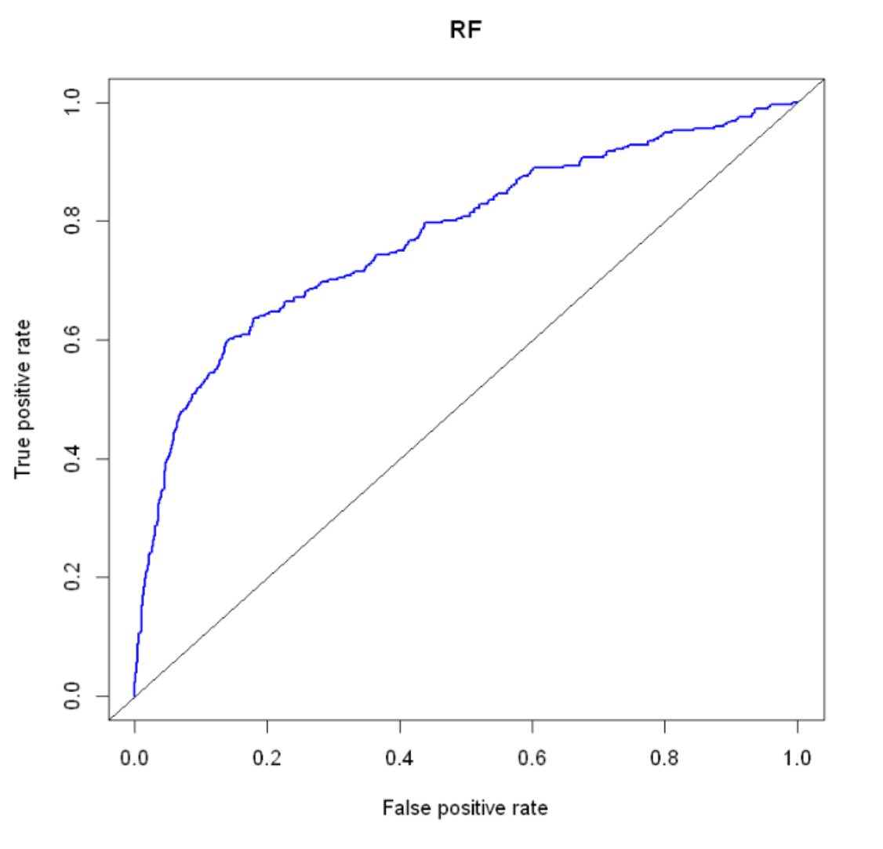
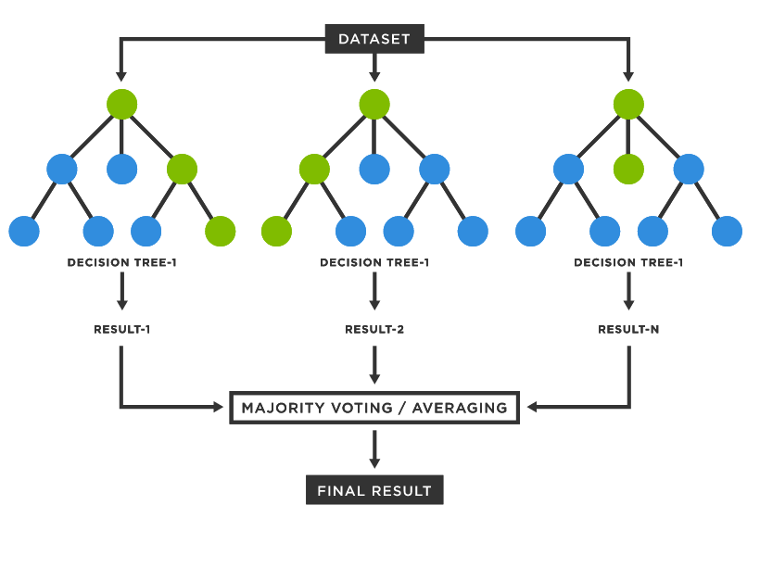
Random Forest Model
Multiple decision trees
Each is trained on a random subset of the data
Data passes through each decision tree and the predictions made by each tree are combined
AUC of 0.7752
Figure 6: Random forest ROC curve
Figure 5: Random forest example
Notes:
Model made up of multiple decision trees
Each is trained on a random subset of the data and makes prediction based on certain features of the data
The data passes through each decision tree and the predictions made by each tree are combined
The final prediction can for instance be the mean of all the predictions
Resistant to overfitting but very computationally expensive
AUC of 0.7752
As effective as logistic regression
Unusual result - perhaps the dataset was too small, the number of features too large or the hyperparameters were poorly chosen

Slide 11
Agenda
Introduction
Logistic Regression Model
Classification Tree Model
Random Forest Model
Neural Network Model
Best Model

Slide 12
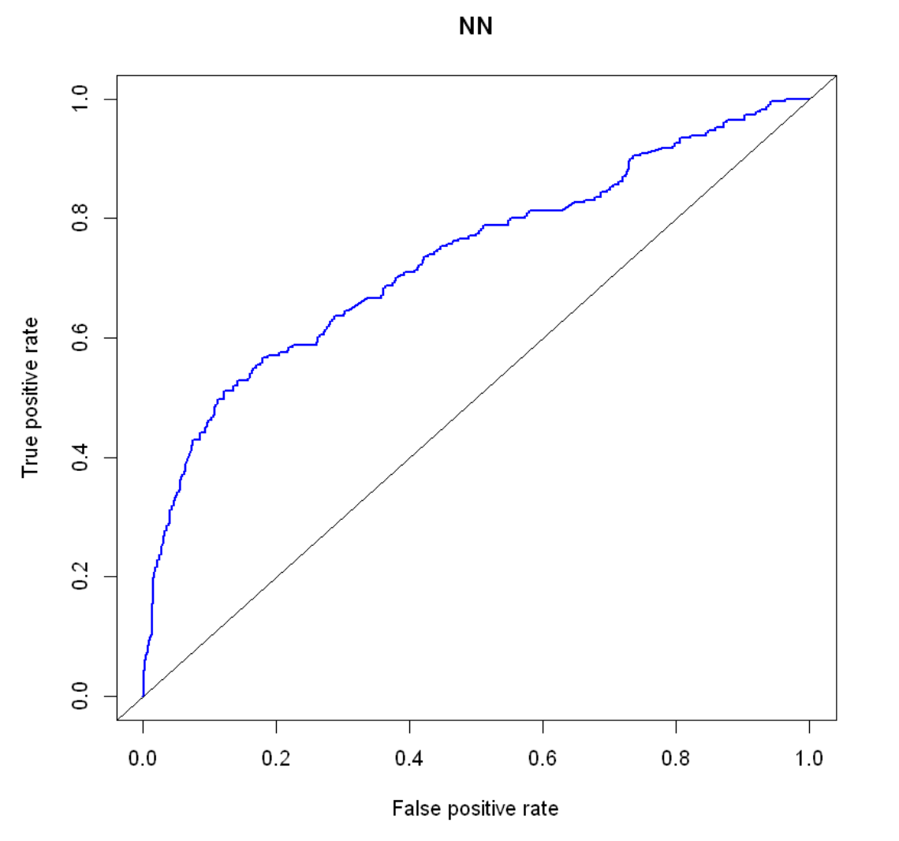
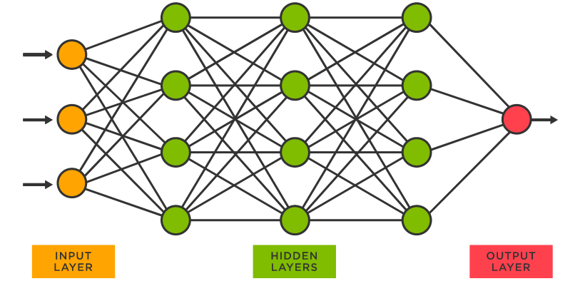
Neural Network Model
A machine learning algorithm which uses layers of neurons to process data and give a result
Neuron weighs its input data to produce a sum as its output
The weights of all neurons are optimized by reducing a loss function, e,g., the sum of squared errors on the input data
Best model with 1 hidden layer of 5 neurons
AUC of 0.7323
Figure 8: Neural network ROC curve
Figure 7: Neural network example
Notes:
A machine learning algorithm which use layers of neurons to process data and give a result
Neurons can be seens as a simple linear classifier that weighs its input data to produce a sum as its output
The weights of all neutrons are optimized by reducing a loss function, e,g., the sum of squared errors on the input data
Can transform data and features to solve non-linear problems
Tends to perform less well on simple problems
The neural network was created with the neuralnet package and the input data was pre-processed
Categorical variables were converted to numerical or boolean and the data was normalized
Disappointing results with the model after experimenting with multiple configurations of hyperparameters
Best model was obtained with one hidden layer of five neurons
AUC of 0.7323

Slide 13
Agenda
Introduction
Logistic Regression Model
Classification Tree Model
Random Forest Model
Neural Network Model
Best Model

Slide 14
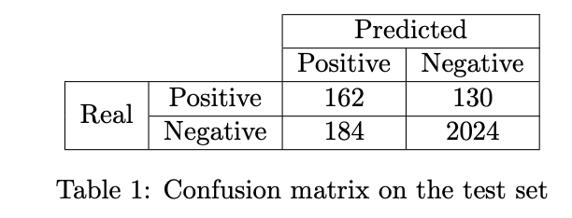
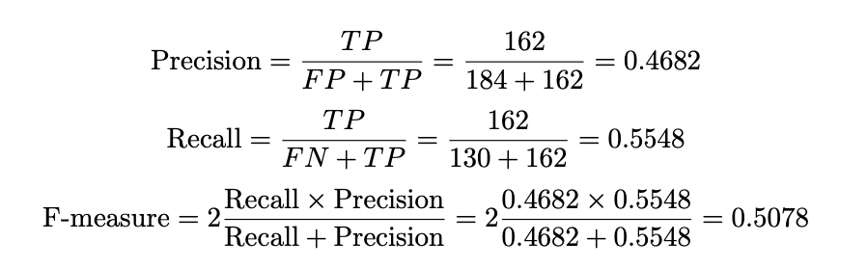
Best Model
Logistic Regression Model performed best
Threshold τ chosen for best F-measure on test set
The highest F-measure was found for:
τ = 0.206272836493452
Notes:
Logistic Regression Model performed best
Threshold τ chosen for best F-measure on test set
The performance function from the ROCR package was used to compute the F-measure for multiple τ on the test set to determine the optimal τ
The highest F-measure was found for τ = 0.206272836493452
Confusion matrix as well as precision, recall and F-measure is shown on the right

Slide 15
Thank you for your attention

